Slide 1
Spring 2011 European Tours Proposal
Ellen Latsky
Tour Developer-Europe
Quest Specialty Travel

Slide 2
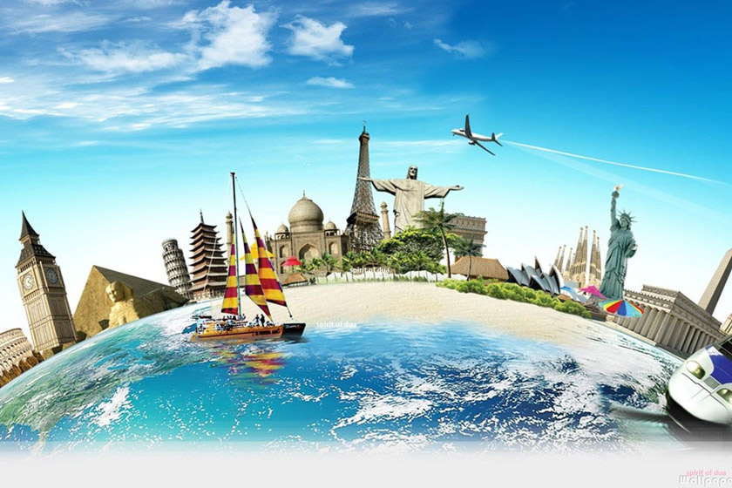
Tour Development Goals
Focus on significant experiences
Preserve QST values
Price tours reasonably
Create learning opportunities
Offer local guides
Provide experts

Slide 3
Tour Strategy Objectives
Provide low cost tours
Use local transportation
Provide educational experiences
Have meaningful cultural exchanges
Utilize local knowledge of geopolitical history
Provide tours for different physical abilities
Aim
Higher

Slide 4
Focus Group Data Analyzed
TRENDS
MAJOR FINDINGS
CONCLUSIONS

Slide 5
Focus Group Analysis-Trends
Trends for American Tourists
Concern for safety a high priority
Middle East and Asian travel less popular
European destinations more popular than Pacific Islands
Trip destination correlated to trip length

Slide 6
Focus Group Analysis-Findings
Major Findings by Age
18-35 - look for adventure
36-49 - seek culture experiences
50-75 - desire to be safe and comfortable
45-70 - travel more than other age groups combined

Slide 7
Focus Group Analysis-Conclusions
General Conclusions
Stress safety issues and concerns
Target tours for 45-65 yr. olds
Target economic travelers of all ages
Expand adventure tour offerings

Slide 8
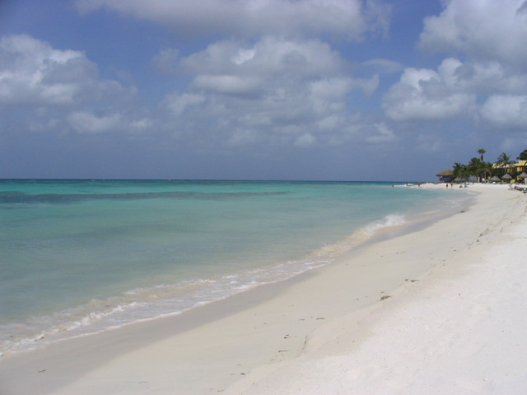
Mediterranean Islands Bike Tour Mallorca Spain
A view of the beach along the north side of Mallorca near the village of Alcudia.
Travel for 135 miles from Palma to La Puebla over 6 days

Slide 9
Online Survey Results

Slide 10
Adventure Series
Self-Guided | Family | Cruise | Extreme
Mallorca Bike Tour | Italian Alps Camping | Mediterranean Catamaran Tour | Russian Arctic Tour
Black Forest Tour | Black Sea Cottage | UK to Spain Ocean Voyage | Climbing Mt. Elbus
Amalfi Coast Walking Tour | Alicante Beach House | Adriatic Sea Cruise | Kerry Coast Biking Tour

